Slide 1
Couchbase

Slide 2

Couchbase: Best Free NoSQL Cloud Database Platform
https://www.couchbase.com/

Slide 3
Couchbase
is a distributed (shared-nothing architecture) multi-model NoSQL document-oriented database software package optimized for interactive applications
applications may serve many concurrent users by creating, storing, retrieving, aggregating, manipulating and presenting data
designed to provide easy-to-scale key-value, or JSON document access, with low latency and high sustainability throughput
designed to be clustered from single machine to very large-scale deployments spanning many machines

Slide 4
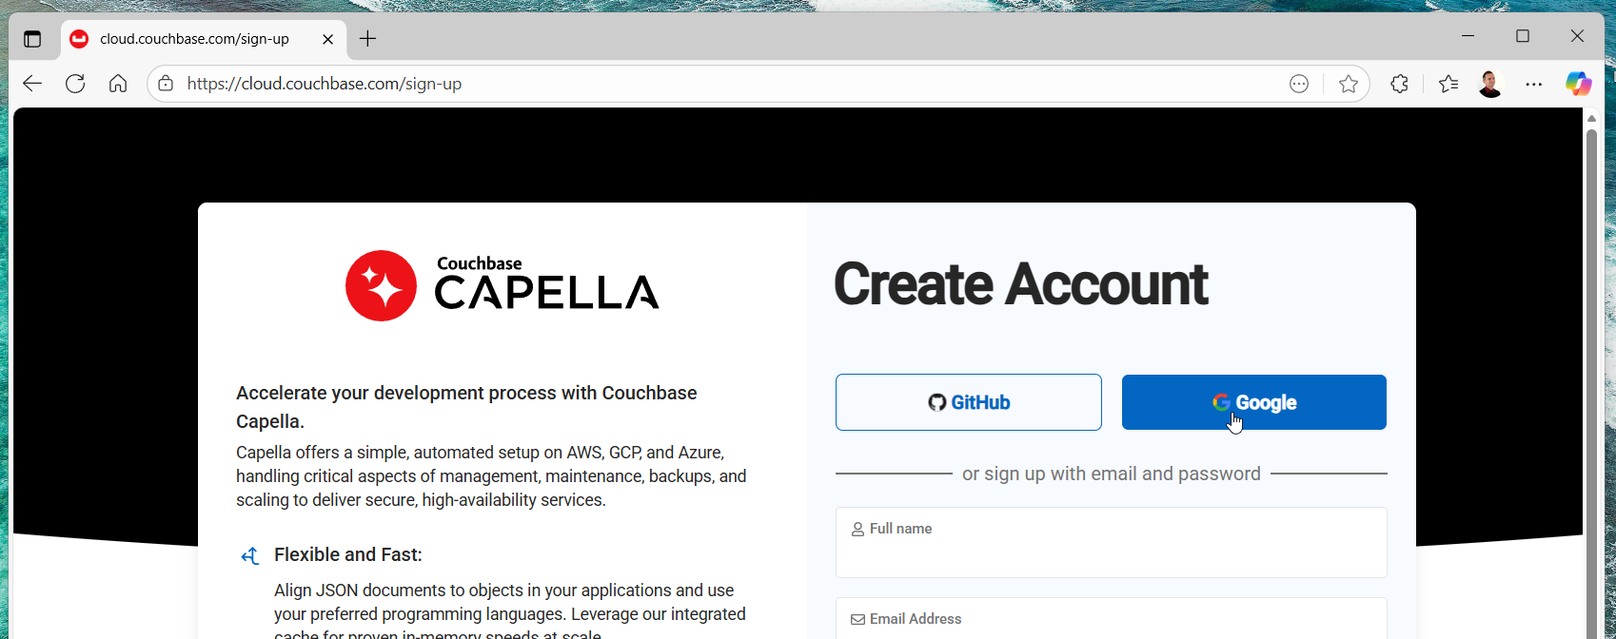
Couchbase Capella cloud.couchbase.com/sign-up

Slide 5
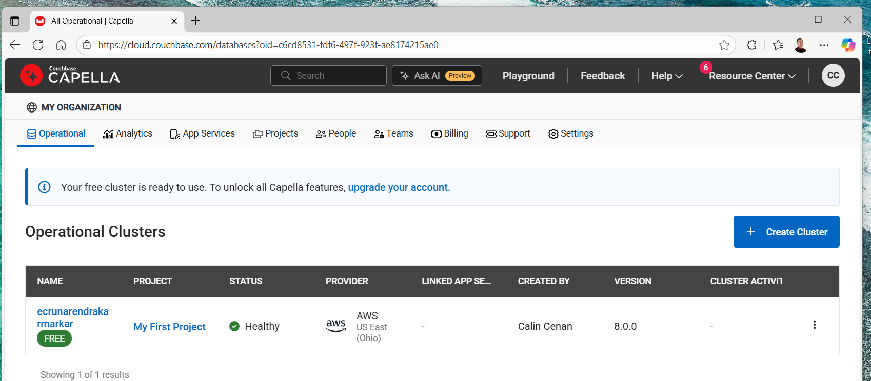

Slide 6
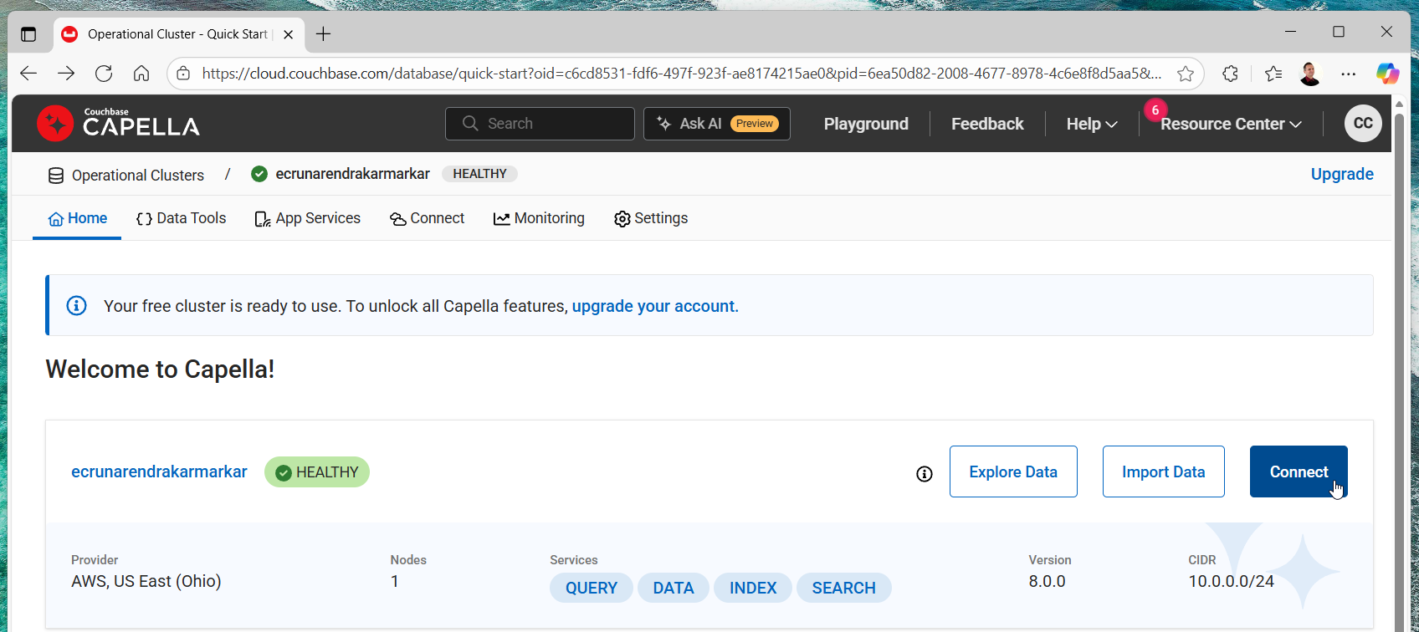

Slide 7
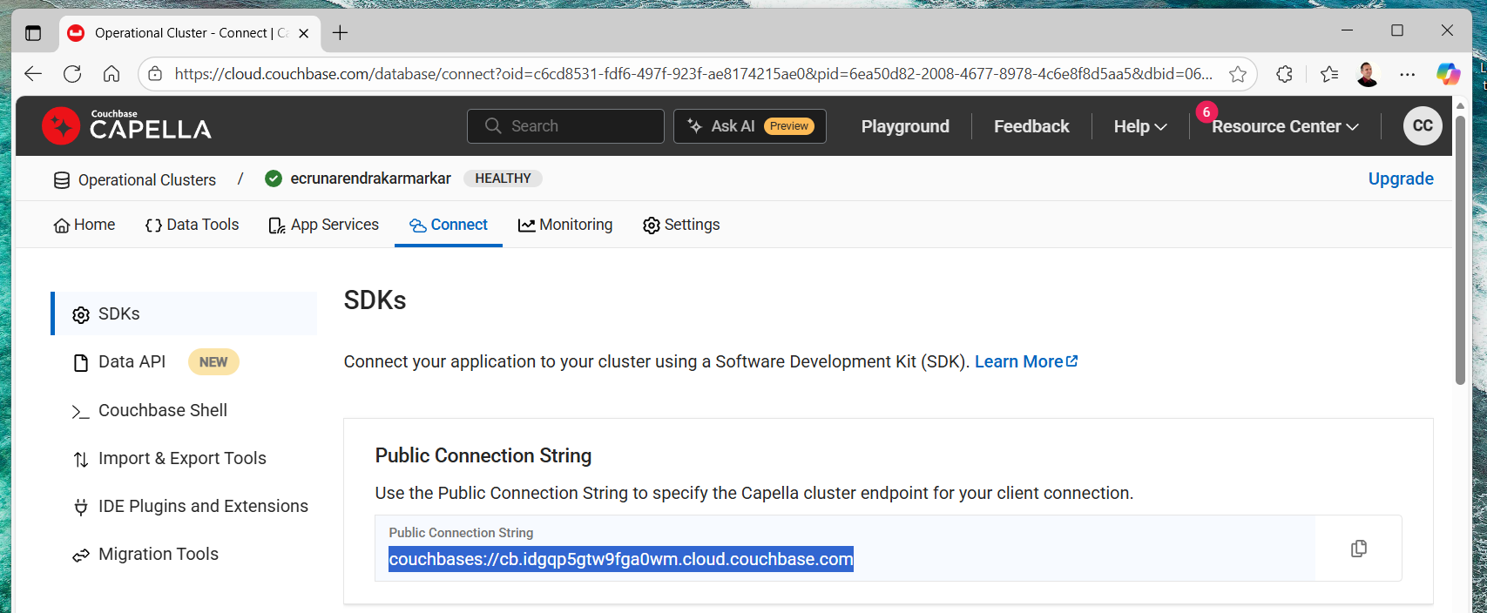

Slide 8
NoSQL
Key-value store: data storage system that uses a key to access values; examples are Redis, Riak, and DynamoDB
Column store: sparse matrix system that uses a row and a column as keys; Apache HBase, Apache Cassandra
Graph store: used for relationship-intensive problems; example is Neo4j
Document store: used to store hierarchical data structures directly in database; example, MongoDB (10Gen), CouchDB, and Couchbase - use case: storing structured information

Slide 9
NoSQL
provides a flexible data model
distributed system, it can scale out horizontally without too many changes in application
provides high availability, since there are multiple servers and data are replicated across nodes

Slide 10
Couchbase
Schema less: don't need to worry about database schema when changing your application object - records can have different structures; there is no fixed schema
  allows changes in data model for rapid application development
flexible data model with JSON support

Slide 11
Couchbase
JSON-based document structure: documents are natively stored as JSON; metadata of the data like types are stored along with data and normally all related information is stored together as single document; when build application, don't require explicit mapping of application objects with that of database schema
Built in clustering with replication
Cache: by default, all documents are stored in RAM, and hence provide a built-in managed cache

Slide 12
Couchbase
Web UI
Varieties of SDK: Software development kits for languages, such as Java, PHP, Python, ..
Couchbase Cluster, there are several nodes, and all nodes are equal; the cluster works on concept of peer-to-peer; can easily scale
Auto-sharding is a feature of NoSQL databases that spreads documents across nodes in a cluster automatically; remains transparent to application that consumes data

Slide 13
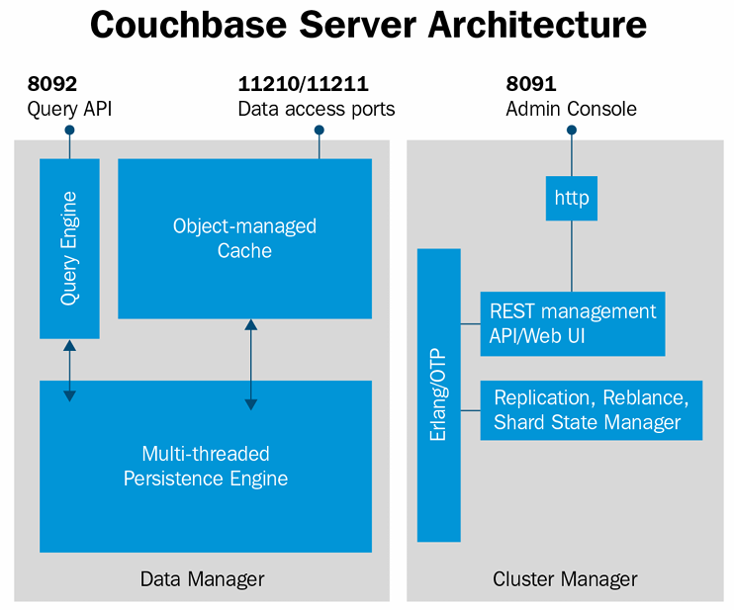

Slide 14
Concepts
Couchbase concepts

Slide 15
Buckets
in RDBMS, usually encapsulate all relevant data for particular application in a database namespace
called a bucket in Couchbase terminology
independent virtual container that groups documents logically; equivalent to a database namespace in RDBMS; can be accessed by various clients in application

Slide 16
Views
enable indexing and querying by looking inside JSON documents for a key, for ranges of keys, or to aggregate data
created using incremental MapReduce, which powers indexing
enable us to define materialized views on JSON documents and then query across the dataset - materialized view is a database object that contains result of MapReduce
can define primary, simple secondary, complex secondary, tertiary, and composite indexes, as well as aggregations (reduction)
developed using MapReduce technology
MapReduce functions are written in JavaScript

Slide 17
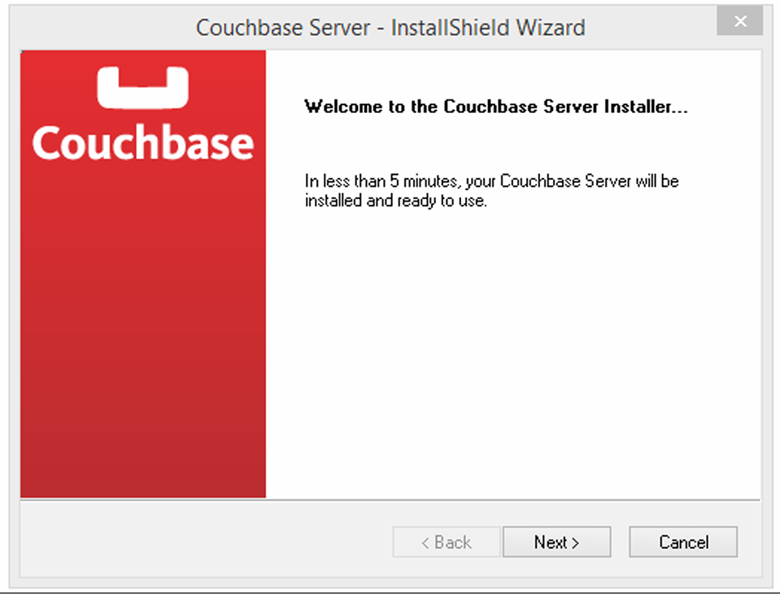
Installation on Linux, MacOS, Windows environments
download couchbase-server-community_8.0.0-windows_amd64 software from www.couchbase.com

Slide 18
need to change some settings before you can use Couchbase
can access the admin console with http://localhost:8091/index.html
default port is 8091; can change this if required

Slide 19
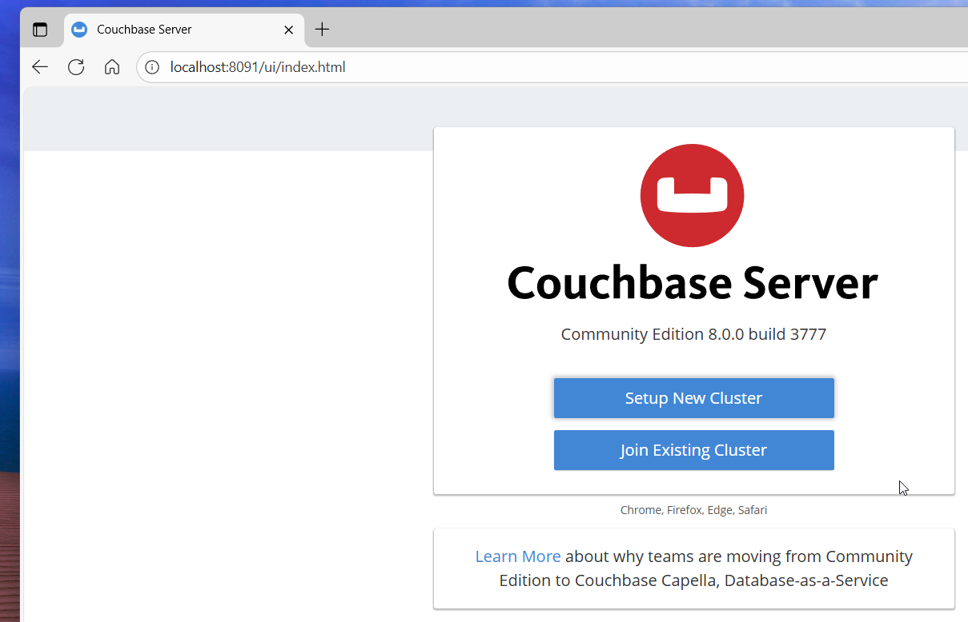

Slide 20
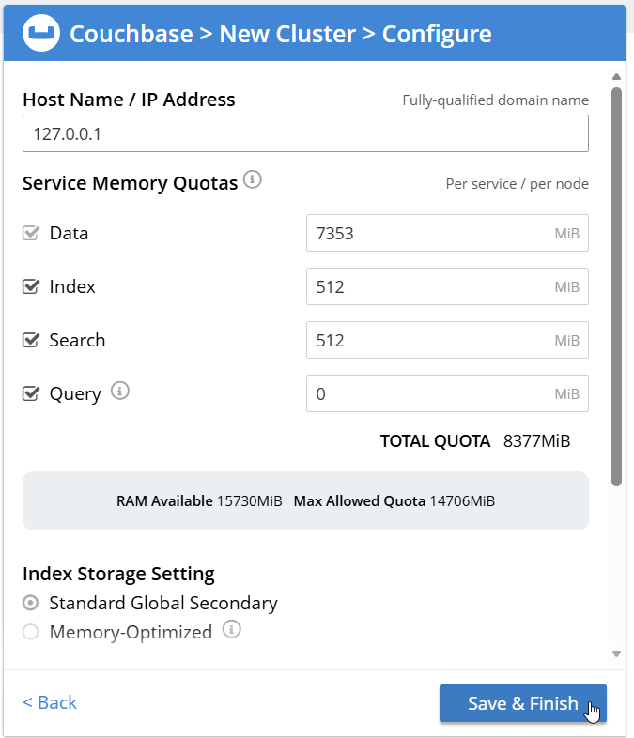
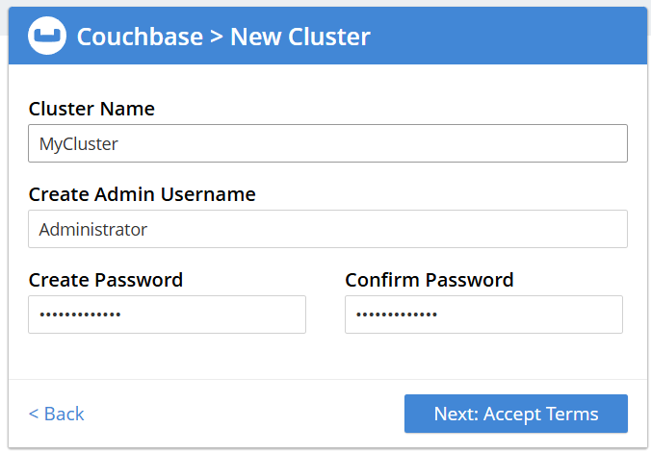

Slide 21
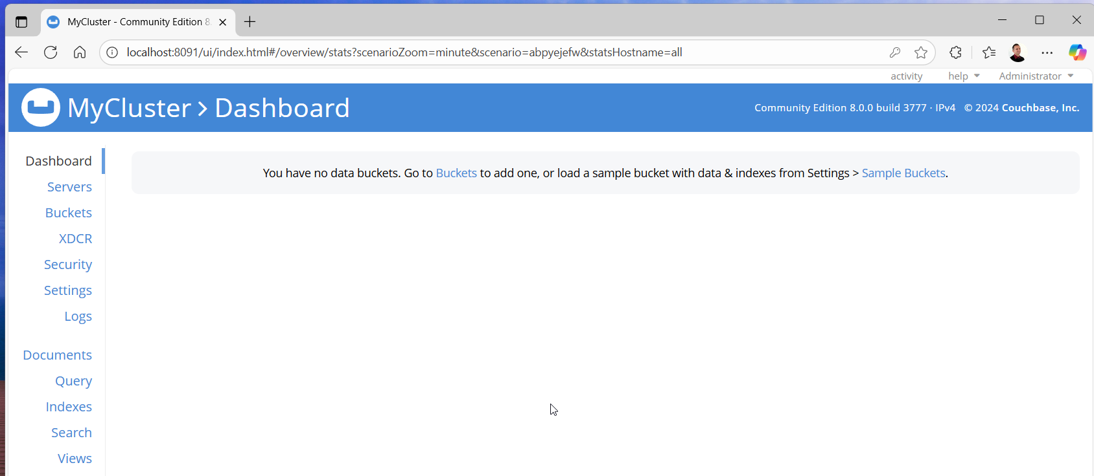

Slide 22
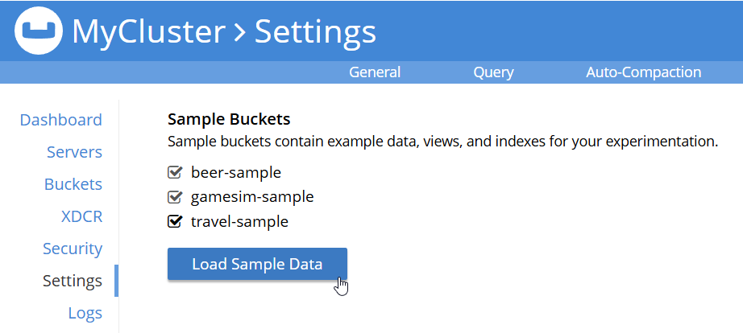
You have no data buckets. Go to Buckets to add one, or load a sample bucket with data & indexes from Settings > Sample Buckets.

Slide 23
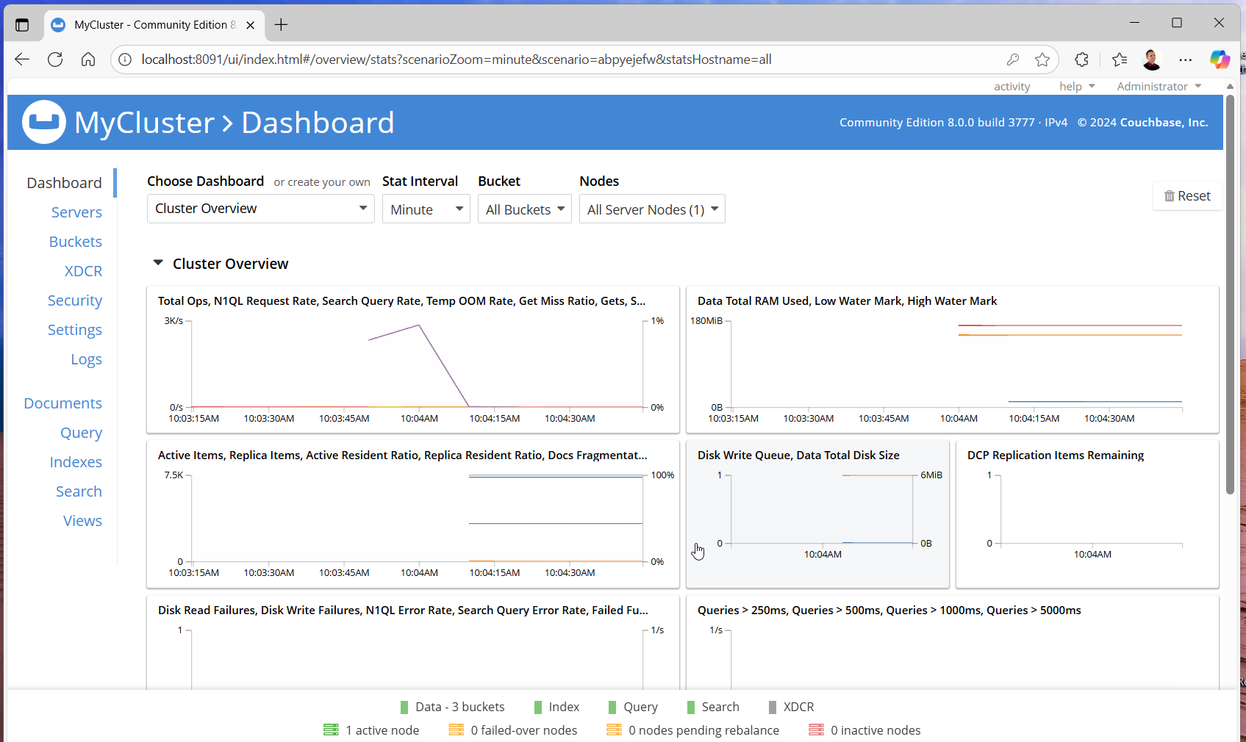

Slide 24
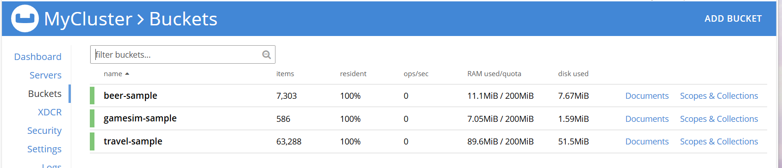
Buckets

Slide 25
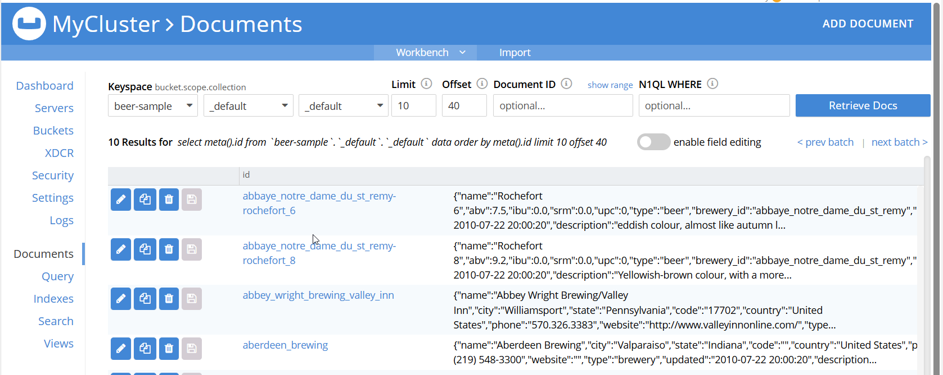
Documents

Slide 26
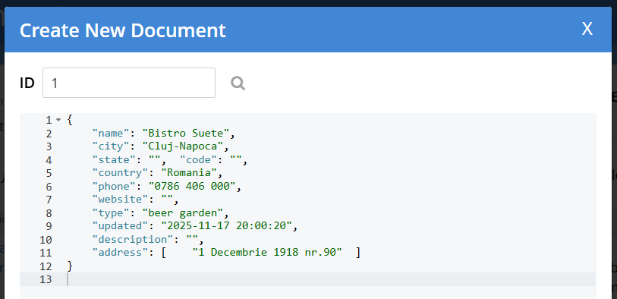

Slide 27
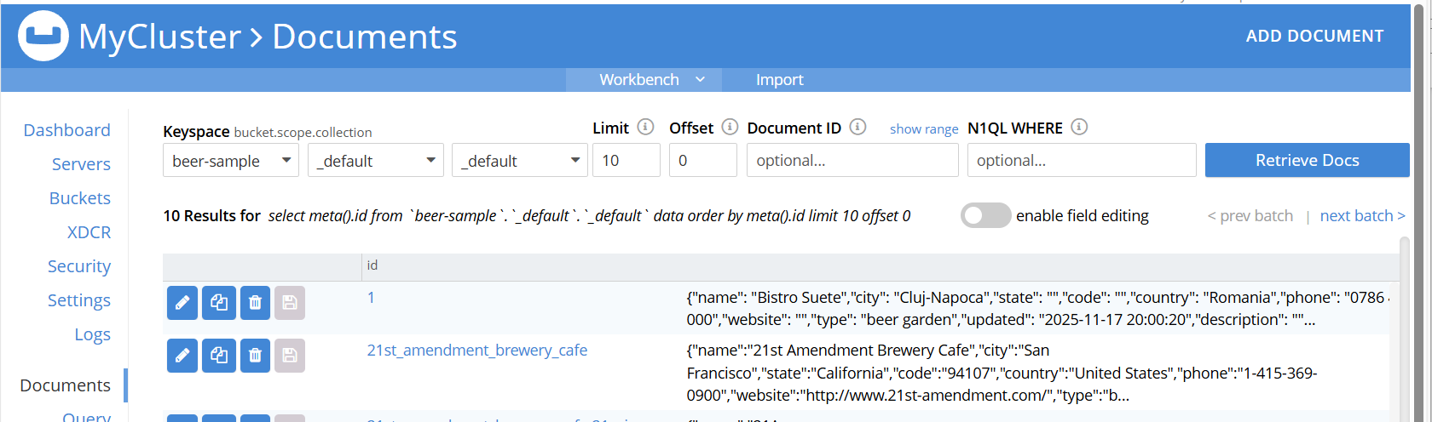

Slide 28
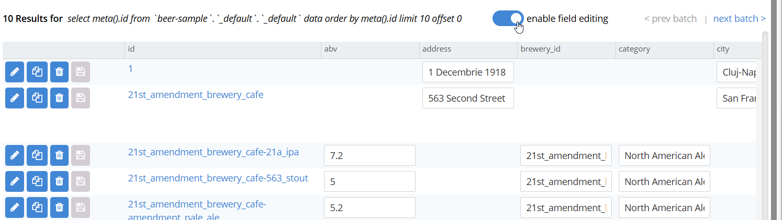

Slide 29
Buckets
can store anything in it as we do in the physical world, hence the name
in Couchbase, namespace for storing data is called bucket
data container that stores data related to applications
partition application data depending on application's requirements
create one bucket for each application
in Couchbase, a bucket is the equivalence of a database
in Couchbase, all data or records, which are referred to as documents, are stored directly in a bucket

Slide 30
can create a separate temporary bucket rather than a regular transaction bucket when you need temporary storage for ad hoc requirements, such as reporting, temporary workspace for application programming, …, so that you can flush out temporary bucket after use

Slide 31
Memcached buckets
buckets of the Memcached type store documents in memory, RAM only; means that documents stored in Memcache bucket are volatile in nature

Slide 32
Couchbase buckets
Couchbase bucket type gives persistence to documents
distributed across a cluster of nodes and can configure replication, which is not supported in Memcached bucket type
highly available, since documents are replicated across nodes in a cluster

Slide 33
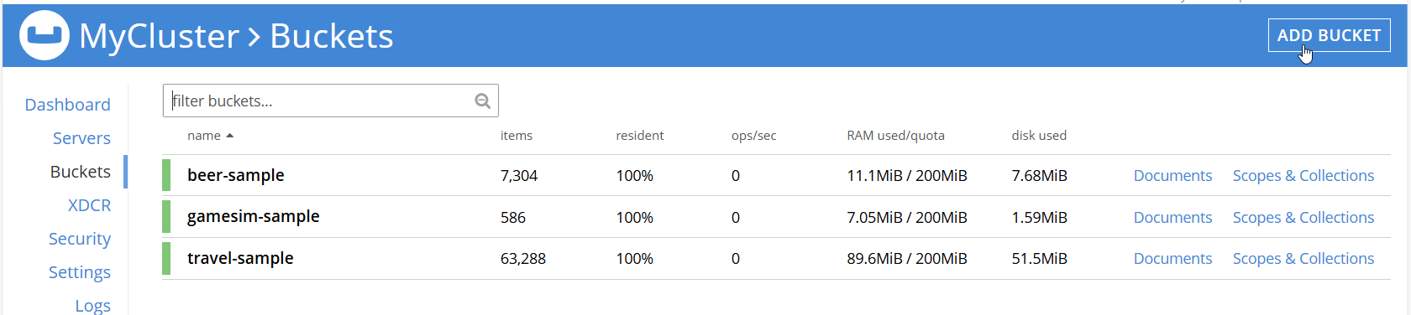
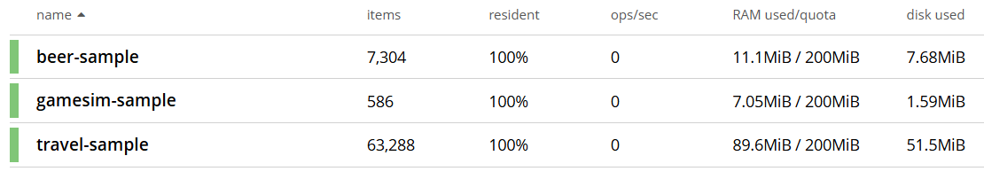

Slide 34
Documents
document is a piece of information or data that gets stored in a bucket
smallest item that can be stored in a bucket
developer will always work on a bucket, in terms of documents
similar to a row in RDBMS table schema
NoSQL databases, including Couchbase, don't require a fixed schema to store documents or data in a particular bucket
documents are represented in the form of JavaScript Object Notation JSON

Slide 35
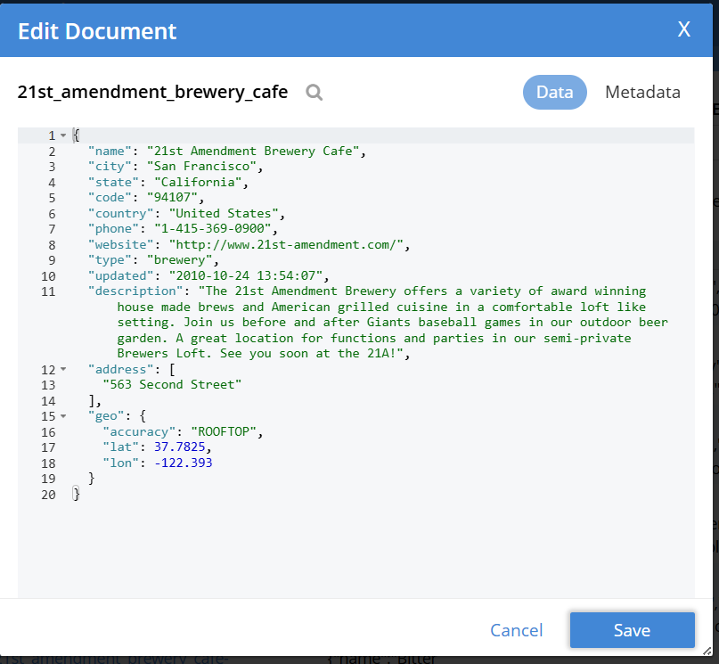

Slide 36
preceding screenshot shows a document
represents a brewery and its document ID is 21st_amendment_brewery_cafe
ID is unique identifier that is assigned for each document in bucket
each document can have multiple properties/items along with its values
for example, name is property and 21st Amendment Brewery Café is value

Slide 37
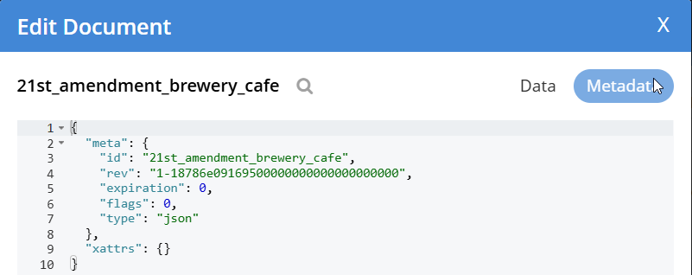
meta information

Slide 38
id: document key is a unique identifier for a document; value of document key can be any string
rev: internal revision ID meant for internal use by Couchbase; it should not be used in application
expiration: if you want your document to expire after certain amount of time, you can set that value; by default, it is 0; that is, the document never expires
flags: numerical values specific to client library that is updated when document is stored
type:
  JSON format: whenever you require a valid form of JSON format
  Binary data: whenever you require any data format other than JSON

Slide 39
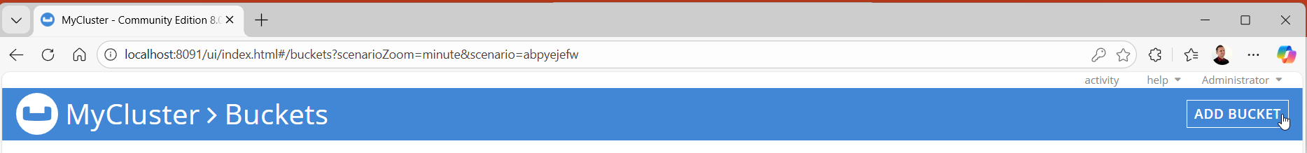
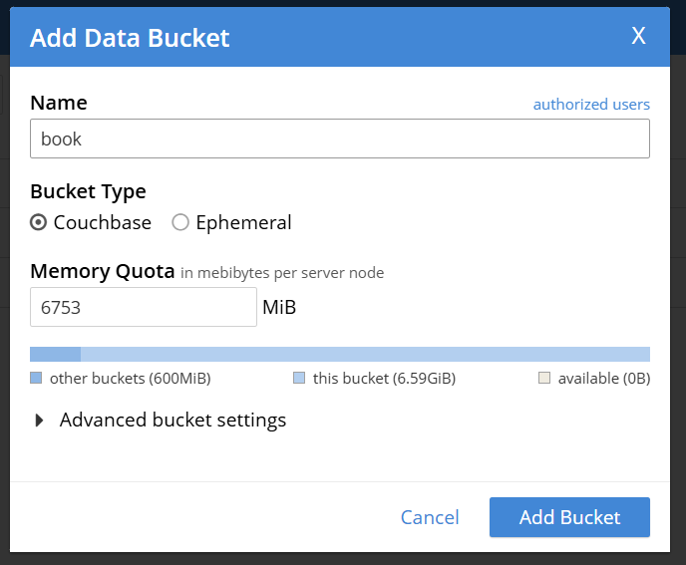
Create
MyCluster > Buckets
Add Bucket

Slide 40
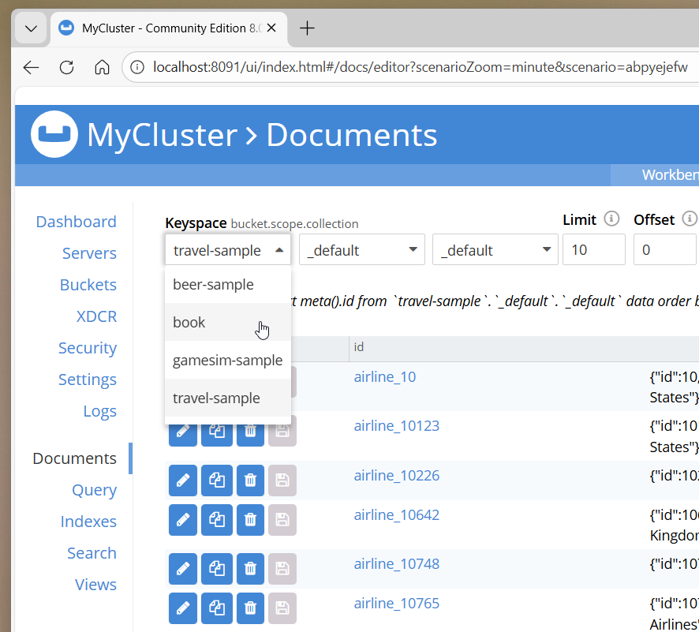
Documents
select
Buckets
  Keyspace

Slide 41
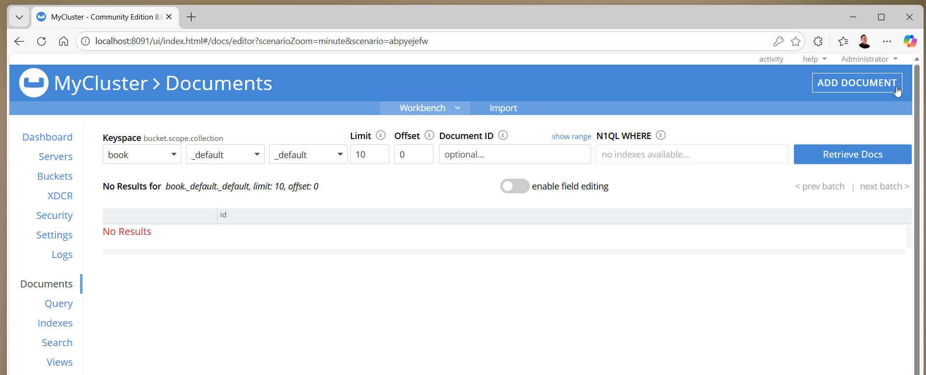

Slide 42
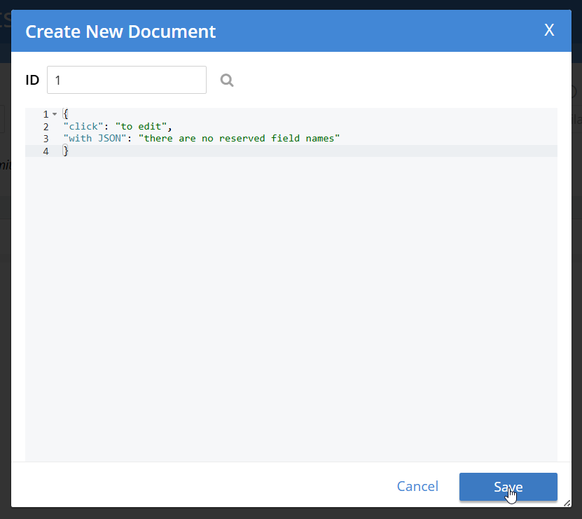
Add Document

Slide 43
ramakrishnan2003database
{
"title": "Database Management Systems",
"author": [
"Ramakrishnan, R.",
"Gehrke, J."
],
"isbn": "9780072465631",
"url": "https://books.google.ro/books?id=JSVhe-WLGZ0C",
"year": 2003,
"publisher": "McGraw-Hill Education"
}

Slide 44
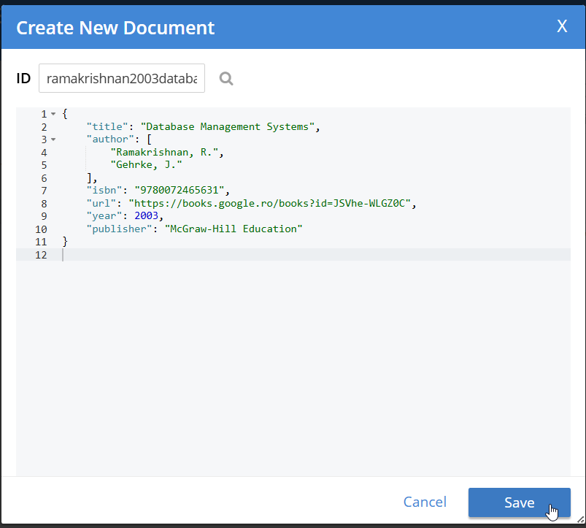

Slide 45
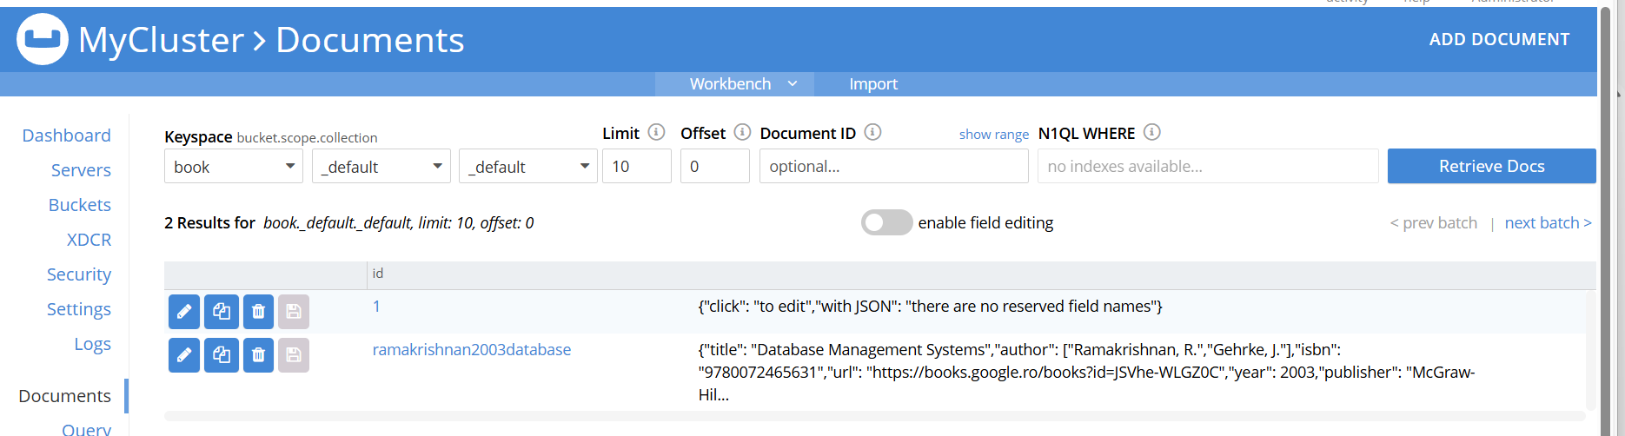

Slide 46
when you click on Create Document, you will be asked to enter the document ID - don't need to generate a unique ID in production manually, there are ways to generate a unique ID depending on the client library that will be used to write a document in Couchbase
will be shown a console where you can enter document in JSON format

Slide 47
Read
can search documents using key only
  should know the key before you need to retrieve it since the only mechanism to fetch document is by using document ID
Couchbase DataBase provides an alternatives mechanism

Slide 48
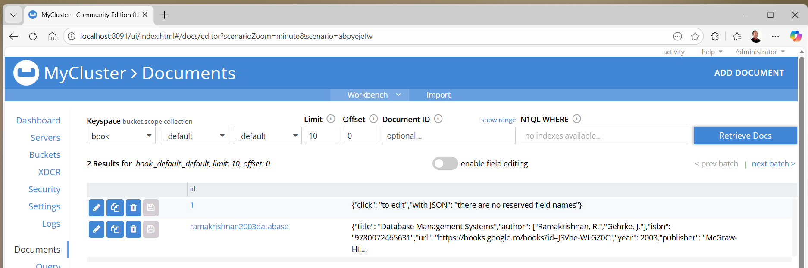

Slide 49
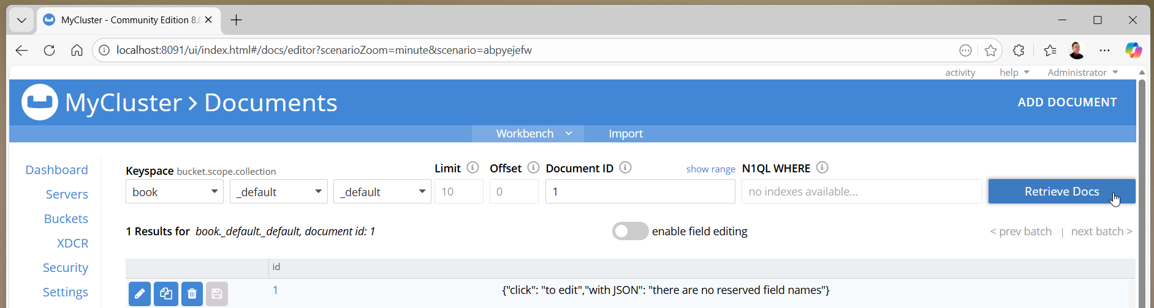

Slide 50
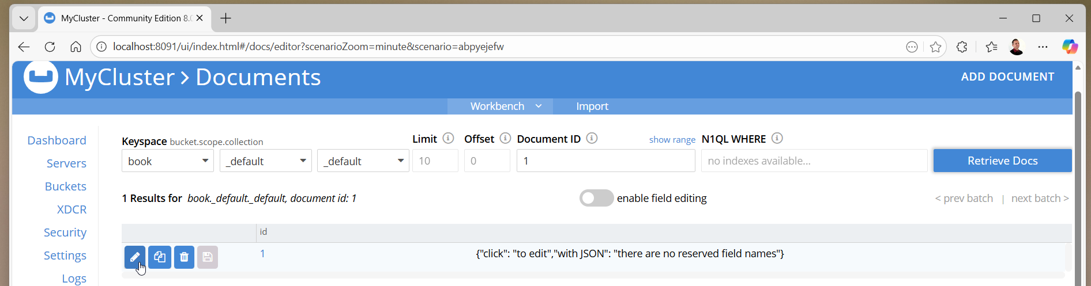
Update

Slide 51

Delete

Slide 52
internals …

Slide 53
vBuckets
helps in replicating documents across the nodes in a cluster
document ID is a unique key per bucket, that is associated with each document
depending on document ID, documents are distributed across nodes in cluster
each bucket is divided into 1024 logical partitions called vBuckets
each partition is bound to particular node in cluster
bindings of vBuckets to server nodes is stored in cluster map, which is a lookup structure
each vBucket will have a subset of document IDs; mechanism allows effective distribution and sharding of documents across nodes in cluster

Slide 54
client derives the node using a hashing algorithm for each document it stores
hashing function algorithm takes the document ID for each document and returns vBucket in which it belongs to and refers to cluster map to determine node to store actual document in
client uses this information to communicate with node directly to store or retrieve document

Slide 55
Couchbase ensures that the most frequently accessed data is stored in RAM, which is an inbuilt caching layer, and boosts performance, but eventually flushes data to disks for persistence

Slide 56
Replication
is configured per bucket, and at most, you can configure up to three replicas
replicas work closely with vBucket structure and cluster map

Slide 57
Rebalancing
if administrators need to expand or shrink the Couchbase server cluster to increase or downsize its capacity, which is very common in cloud environment for elasticity, then information stored in vBuckets needs to be redistributed between available nodes with a process called rebalancing, in which corresponding vBucket cluster map is updated to reflect new structure

Slide 58
Designing a Document

Slide 59
JSON JavaScript Object Notation
is a text format that is completely language-independent and a lightweight data interchange format
collection of name and value pairs
ordered list of values: represented as an array, vector, or list

Slide 60
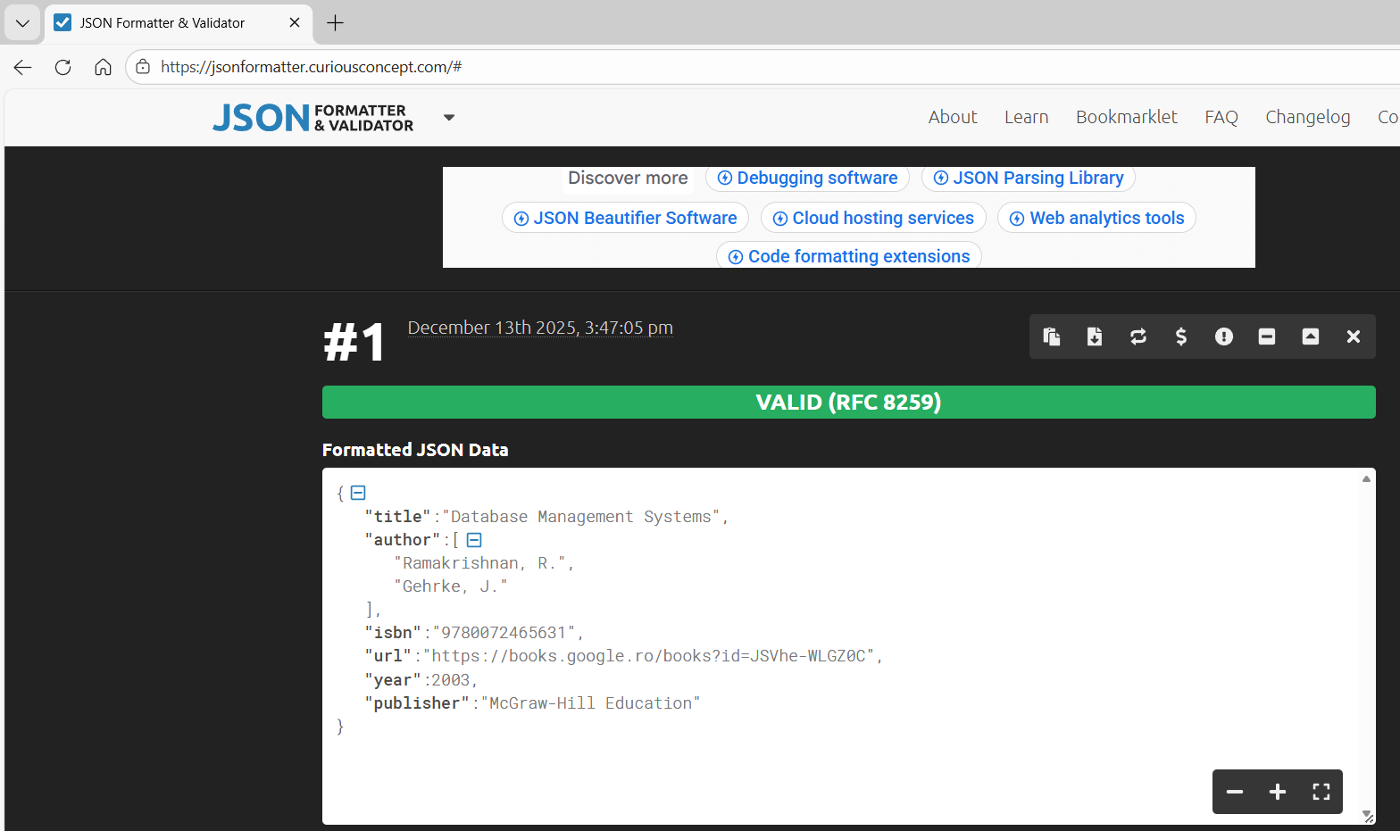

Slide 61
Data Types
title String DataBase Management Systems
author Array ["Ramakrishnan, R.", "Gehrke, J." ]
year Numeric 2003
active Boolean true
expire Time Stamp 2055/05/50 17:05:05

Slide 62
{
"title": "Database Management Systems",
"author": [
"Ramakrishnan, R.",
"Gehrke, J."
],
"isbn": "9780072465631",
"url": "https://books.google.ro/books?id=JSVhe-WLGZ0C",
"year": 2003,
"publisher": "McGraw-Hill Education",
"active": true,
"expire": "20205/05/05 17:05:05"
}

Slide 63
Document
RDBMS
it is schemaless
metadata about attributes goes, or is stored, with data itself
atomicity is for single document
no joins are allowed between documents
transactions are on a single document only
good for structured and unstructured data
can handle big data without much cost
schema needs to be defined in terms of table structures
records are stored individually and without attributes
supports ACID properties
joins are supported across table
support transactions
good for structured data
handling big data is expensive

Slide 64
One document vs. Multiple documents
One Document
Multime Documents
denormalized data format, in which all information is stored together in a single document
leads to better performance since all information is kept together
don't need to join document since all related information is at a single document
information will be split into multiple documents thereby normalizing data
there is an impact on performance, since related documents are scattered across nodes
join is not supported, while the application logic requires it

Slide 65
{
"order": [
{
"order_id" : 10248,
"order_date" : "1996-07-04",
"company_name" : "Vins et alcools Chevalier",
"product_name" : "Queso Cabrales",
"quantity" : 12,
"unit_price" : 14.0
},

Slide 66
{
"order_id" : 10248,
"order_date" : "1996-07-04",
"company_name" : "Vins et alcools Chevalier",
"product_name" : "Singaporean Hokkien Fried Mee",
"quantity" : 10,
"unit_price" : 9.8
},

Slide 67
{
"order_id" : 10248,
"order_date" : "1996-07-04",
"company_name" : "Vins et alcools Chevalier",
"product_name" : "Mozzarella di Giovanni",
"quantity" : 5,
"unit_price" : 34.8
}
]}

Slide 68
{ "order_id" : 10248,
"order_date" : "1996-07-04",
"company_name" : "Vins et alcools Chevalier",
"detail": [ {
"product_name" : "Queso Cabrales",
"quantity" : 12,
"unit_price" : 14.0
}, {
"product_name" : "Singaporean Hokkien Fried Mee",
"quantity" : 10,
"unit_price" : 9.8
}, {
"product_name" : "Mozzarella di Giovanni",
"quantity" : 5,
"unit_price" : 34.8 } ]}

Slide 69
Document relationships
in document-based database system don't need to worry about altering tables when there are changes in schema, as we do in RDBMS
all schemas of document are driven by application code only
schema of a document goes along with the document itself as metadata

Slide 70
can store the company_name or the customer_id value in Order document

Slide 71
Client

Slide 72
dataauth.py
# Update this to your cluster
servername ="couchbase://localhost"
username = "Administrator"
password = "Administrator"

Slide 73
1One.py
import dataauth as da
# needed for any cluster connection
from couchbase.cluster import Cluster
from couchbase.auth import PasswordAuthenticator
# options for a cluster and SQL++ (N1QL) queries
from couchbase.options import ClusterOptions, QueryOptions
# get a reference to our cluster
cluster = Cluster.connect(da.servername, ClusterOptions ( PasswordAuthenticator (da.username, da.password)))

Slide 74
bucket_name = "travel-sample"
# get a reference to our bucket
cb = cluster.bucket('travel-sample')
# get a reference to the default collection
cb_coll = cb.default_collection()
# get a document
result = cb_coll.get('airline_10')
print(result.content_as[dict])
res = result.valueprint(res)
print(f"{res["name"]} is {res["type"]} with call sign: {res["callsign"]}")

Slide 75
python3 1One.py
{'id': 10, 'type': 'airline', 'name': '40-Mile Air', 'iata': 'Q5', 'icao': 'MLA', 'callsign': 'MILE-AIR', 'country': 'United States'}
{'id': 10, 'type': 'airline', 'name': '40-Mile Air', 'iata': 'Q5', 'icao': 'MLA', 'callsign': 'MILE-AIR', 'country': 'United States'}
40-Mile Air is airline with call sign: MILE-AIR

Slide 76
CAS
setting a Compare and Swap (CAS) value is a form of optimistic locking
CAS is a value representing the current state of an item; each time item is modified, its CAS changes
CAS value is returned as part of a document’s metadata whenever a document is accessed
without explicitly setting it, a newly-created document would have a CAS value of 0

Slide 77
Insert.Py
bucket = cluster.bucket("travel-sample")
collection = bucket.default_collection()
document = {"foo": "bar", "bar": "foo"}
result = collection.insert("document-key", document)
cas = result.cas
# end::insert

Slide 78
Insert.Py
print(result)
print(cas)
result = collection.get('documentkey')
print(result.content_as[dict])

Slide 79
python3 2TwoInsert.py
Insert ...
MutationResult:result:{value={'cas': 1765982205516316672, 'key': 'document-key', 'mutation_token': <pycbc_core.mutation_token object at 0x7fa139919ef0>}}
1765982205516316672
{'foo': 'bar', 'bar': 'foo'}

Slide 80
2InserTarom.py
bucket = cluster.bucket("travel-sample")
collection = bucket.default_collection()
print("\nInsert …")
document = {'id': 101, 'type': 'airline', 'name': 'Tarom', \ 'iata': 'RO', 'icao': 'ROT', 'callsign': 'Tar-Rom', 'country': 'Romania'}
result = collection.insert("101", document)
cas = result.cas
# end::insert

Slide 81
2InserTarom.py
# end::insert
result = collection.get('101')
print(result.content_as[dict])

Slide 82
python3 2TwoInserTarom.py
Insert ...
{'id': 101, 'type': 'airline', 'name': 'Tarom', 'iata': 'RO', 'icao': 'ROT', 'callsign': 'Tar-Rom', 'country': 'Romania'}

Slide 83
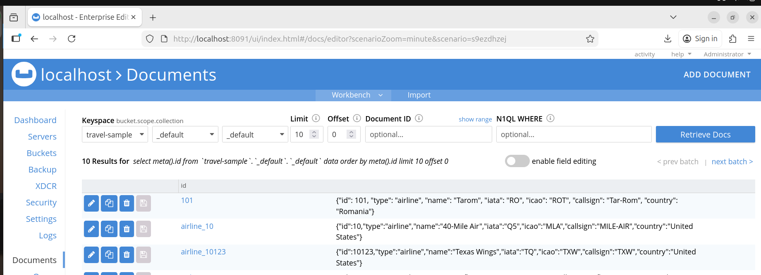

Slide 84
2UpdateTarom.py
import dataauth as da
# needed for any cluster connection
from couchbase.cluster import Cluster
from couchbase.auth import PasswordAuthenticator
# options for a cluster and SQL++ (N1QL) queries
from couchbase.options import ClusterOptions, QueryOptions
from couchbase.options import ReplaceOptions
from couchbase.exceptions import CouchbaseException, CASMismatchException

Slide 85
2UpdateTarom.py
# get a reference to our cluster
cluster = Cluster.connect(da.servername, ClusterOptions( PasswordAuthenticator(da.username, da.password)))
bucket = cluster.bucket("travel-sample")
collection = bucket.default_collection()

Slide 86
2UpdateTarom.py
print("\nUpdate …")
try:
# tag::get_cas_replace
# Replace document with CAS
result = collection.get("101")
doc = result.content_as[dict]
doc["name"] = "CAROM"

Slide 87
2UpdateTarom.py
try:
doc["name"] = "CAROM"
opts = ReplaceOptions(cas=result.cas)
result = collection.replace("101", doc, opts)
# end::get_cas_replace
except CASMismatchException as ex: print(ex)

Slide 88


Slide 89
CRUD
Create
Read
Update
  Upsert
Delete

Slide 90
CreateTarom.py
print("\nCreate …")
document = {'id': 101, 'type': 'airline', 'name': 'Tarom', \ 'iata': 'RO', 'icao': 'ROT', 'callsign': 'Tar-Rom', 'country': 'Romania'}
result = collection.insert("101", document)
cas = result.cas
# end::insert[]

Slide 91
ReadTarom.py
print("\nRead …")
result = collection.get('101')
print(result.content_as[dict])
# end::read[]

Slide 92
UpdateTarom.py
try: # tag::get_cas_replace[]
# Replace document with CAS
result = collection.get("101")
doc = result.content_as[dict]
doc["name"] = "CAROM"
opts = ReplaceOptions(cas=result.cas)
result = collection.replace("101", doc, opts)
# end::get_cas_replace[]
except CASMismatchException as ex:
print(ex)

Slide 93
UpsertTarom.py
try: # tag::durability[]
# Upsert with Durability
document = {'id': 111, 'type': 'airline', 'name': 'Tarom', \ 'iata': 'RO', 'icao': 'ROT', 'callsign': 'Tar-Rom', 'country': 'Romania'}
result=collection.upsert("111", document, expiry=timedelta( seconds=300))
# end::durability[]
except CouchbaseException as ex:
# we expect an exception as Durability requires appropriately configured cluster
pass

Slide 94
UpsertCarom.py
try: # tag::durability[]
# Upsert with Durability
document = {'id': 111, 'type': 'airline', 'name': 'Carom', \ 'iata': 'RO', 'icao': 'COT', 'callsign': 'Cart-Rom', 'country': 'Romania'}
result=collection.upsert("111", document, expiry=timedelta( seconds=300))
# end::durability[]
except CouchbaseException as ex:
# we expect an exception as Durability requires appropriately configured cluster
pass

Slide 95
DeleteTarom.py
print("\nDelete …")
# remove document with options
result = collection.remove("101")

Slide 96
Durability
writes in Couchbase are written to single node, and from there the server will take care of sending that mutation to any configured replicas
optional durability parameter, which all mutating operations accept, allows application to wait until this replication (or persistence) is successful before proceeding

Slide 97
durability levels:
Majority - server will ensure that the change is available in memory on majority of configured replicas
MajorityAndPersistToActive - majority level, plus persisted to disk on active nodes
PersistToMajority - majority level, plus persisted to disk on majority of configured replicas

Slide 98
Expiration
options like timeout and expiry are timedelta objects
result = collection.insert("document-key",
document,
opts,
expiry=timedelta(seconds=30))

Slide 99
Expiration
sets an explicit time to live (TTL) for a document
by default, Couchbase documents do not expire, but transient or temporary data may be needed for user sessions, caches, or other temporary documents
can use expiration values on documents to handle transient data
to prevent document from expiring you can use Touch operations which will extend expiry by the time specified
result = collection.touch("document-key", timedelta(seconds=10))
result = collection.touch("document-key", timedelta(seconds=100))

Slide 100
Expiration
when getting a document, the expiry is not provided automatically but it can be requested:
result = collection.get("document-key", GetOptions(with_expiry=True))
print("Expiry of result: {}".format(result.expiryTime))

Slide 101
Views

Slide 102
retrieving documents using document ID only
to fetch documents using attributes other than document ID
functionality provided by a mechanism called MapReduce programming, which is referred to as the term view in the Couchbase terminology

Slide 103
MapReduce
is a way of programming, an abstract concept
need to think in terms of MapReduce while developing applications using views to fetch documents
when write a view in Couchbase to fetch documents from a bucket, we will be writing in the MapReduce format

Slide 104
MapReduce Example
an example of a retail company, that sells consumer goods such as clothes, shoes, … across continents and it has thousands outlets all over the world
all transactions that occurred everyday are centrally collected and stored in (possible Couchbase) cluster; data that gets generated everyday is about one - 1 TB and cluster consists of hundred nodes, each having storage capacity of tens – 10 TB
reward the outlet that has performed the best

Slide 105
there is no way a single machine can handle such a mammoth task of processing hundreds * tens TB data
program goes to each of the nodes and performs processing on each node on the data that is stored in that particular node, the process executed in each node is called Map
output from each node is consolidated in a single process by the key, which is the Reduce phase
minimizes fetching of all documents at one node for overall aggregation
aggregated in a single node after preprocessing each document, at each of the nodes where the document is stored

Slide 106
each of records in group or collection of input will be passed through the map function - output will be in the form of key and value
reduce method will accept key and value, which is an array as a parameters - reduce function will be called for each distinct key emitted from map function as key parameter along with values array that has same key
grouping values of same key in the form of an array or list and passing it as a parameter to a reduce task

Slide 107
Views
whenever we want to extract fields from JSON documents without the document ID, we use views
to find a document or fetch information about document with attributes or fields of a document other than document ID, a view is the way
Views are written in the form of MapReduce; it consists of map and reduce phase

Slide 108
Views enable indexing and querying of data
views are deprecated in Couchbase Server 7.0 and later versions – 2021
views support in Couchbase Server will be removed in future release
instead of views, use indexes and queries using Index Service (GSI) and the Query Service (SQL++)

